Slide 1
The association between incarceration and transactional sex among HIV-positive young MSM in the United States
Morgan M. Philbin, PhD, MHS
Columbia University Mailman School of Public Health
July 25, 2018

Slide 2
no conflicts of interest to declare.

Slide 3
Acknowledgments
Collaborators
Elizabeth N. Kinnard, MS
Amanda E. Tanner, PhD, MPH
Samuella Ware, MPH
Brittany D. Chambers, PhD, MPH
Alice Ma, PhD, MPH
J. Dennis Fortenberry, MD, MS
The Adolescent Trials Network for HIV/AIDS Interventions (ATN)
Funders
Eunice Kennedy Shriver National Institute of Child Health & Human Development (3U01 HD040533-09S1; Protocol Chair Amanda E. Tanner)
National Institute on Drug Abuse (K01DA039804; PI Morgan Philbin)
Notes:
Added my MPH.

Slide 4
Background
Criminal justice practices in the U.S. disproportionately affect sexual and racial/ethnic minority men, who are at higher risk of incarceration
There are a constellation of sexual risk behaviors—e.g., concurrent partnerships, non-consensual sex, and transactional sex — that often occur post-incarceration
While research has explored the association between incarceration and sexual risk behaviors for MSM, previous work among YMSM has focused on the impact of cumulative life stressors, not incarceration specifically
Wilson et al (2017); Himmelstein & Brucker (2011); Meyer et al (2017); Hanssens et al (2014); Garnette et al (2011); Adams et al (2011); Coatsworth et al (2017); Khan et al (2009); Epperson et al (2010); Voisin et al (2017)

Slide 5
Objective
Little research has examined the specific relationship between incarceration and transactional sex among YMSM (particularly in the U.S.)
Despite 6–44% of YMSM reporting transactional sex
Thus, we explored the association between incarceration and transactional sex among HIV-infected YMSM
Bauermeister et al (2017) ; Voisin et al (2017); , Jones et al (2008)
Notes:
I THINK THIS COULD BE SHORTENED TO ONE BULLET…

Slide 6
Methods
Data came from the Comprehensive Assessment of Transition & Coordination for HIV-infected Youth as they Move from Adolescent to Adult Care (CATCH) study
Recruited 97 HIV-positive YMSM
14 Adolescent Trials Network clinical sites
August 2015 to February 2016

Slide 7
Methods
Youth provided consent & completed an ACASI survey (audio computer-assisted self-interview)
Psychosocial characteristics and medical/behavioral history
Variables of interest included
Incarceration (i.e., ever been in jail/prison)
Transactional sex (i.e., ever exchanged sex for money or drugs)
We used descriptive statistics & multivariate logistic regression to examine the association between incarceration and transactional sex

Slide 8
Results
TABLE 1. Demographic characteristics of 97 HIV-infected YMSM
Characteristic | Total (%) (N = 97)
Age
24 or older | 76 (78.4)
Less than 24 | 21 (21.6)
Race/ethnicity
White/Non-Hispanic | 5 (5.2)
Person of color/Hispanic | 92 (94.8)
Relationship status
In a relationship | 25 (25.8)
Single/other | 72 (74.2)
Education
Currently in school/graduated | 45 (46.4)
Not in school | 52 (53.6)
Ever homeless
Yes | 40 (41.2)
No | 57 (58.8)
Annual income
Less than $12,000 in the past year | 58 (59.8)
$12,000 or more in the past year | 33 (34.0)
Insurance status (current)
Insured | 87 (89.7)
Uninsured/don’t know | 10 (10.3)
Monthly use of cannabis#
Yes | 54 (55.7)
No | 43 (44.3)
Monthly use of other drugs#†
Yes | 13 (13.4)
No | 84 (86.6)
Ever incarcerated‡
Yes | 41 (42.3)
No | 56 (57.7)
Ever engaged in transactional sex
Yes | 27 (27.8)
No | 70 (72.2)
Most YMSM were:
24 years old (78%)
racial/ethnic minority (95%)
not in school (54%)
single (74%)
earned <$12,000/year (60%)
Nearly half had ever been homeless (41%)
42% had been incarcerated
28% had engaged in transactional sex
Notes:
Note: percentages do not sum to 100% on some variables due to missing data.
# Monthly denotes at least monthly (i.e. monthly, weekly, or daily) use
† Other drugs include non tobacco, alcohol, or cannabis (i.e. nonmedical use of cocaine, stimulants, inhalants, sedatives, anxiety medications, sleeping pills, hallucinogens, opioids/pain medication, ADHD medication)
‡ Ever been put in jail or prison, held overnight after an arrest, or put in juvenile detention

Slide 9
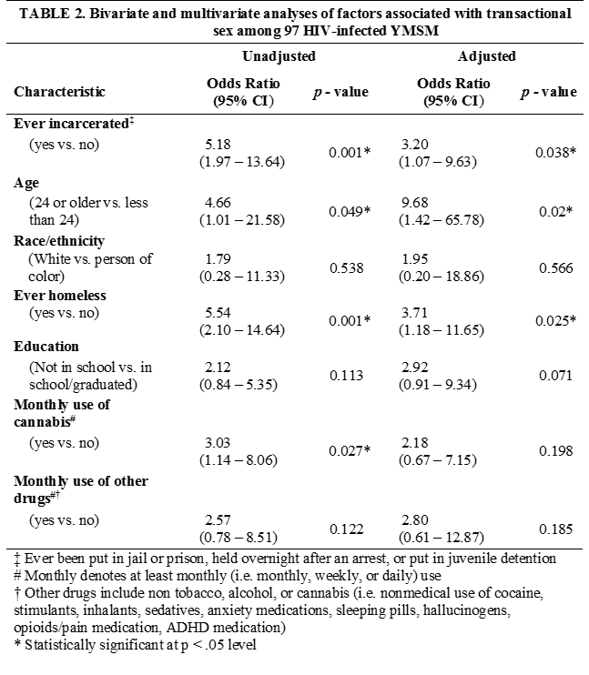
Results Cont.
In the multivariate model…
Having ever been incarcerated (aOR=3.20)
Being 24 years old versus younger (aOR=9.68)
Having ever been homeless (aOR=3.71)
…were independently associated with having engaged in transactional sex.

Slide 10
Discussion
Incarceration represents a particularly severe stressor for young men with multiple marginalized identities—HIV-positive, MSM, and racial/ethnic minority
Placing them at higher risk for engaging in transactional sex
Transactional sex occurs within a broader structural context of social and economic instability (e.g. criminal justice contact, homelessness)
Continued enforcement of racialized, punitive policies related to substance use and transactional sex perpetuates the cycle of incarceration and associated risk behaviors for YMSM of color
Oldenburg et al (2015); Bland et al (2012), Schulz et al (2006); Drug Policy Alliance (2017); Carson (2015); Dwyer (2017); Judge & Wood (2014)

Slide 11
Conclusion
Tracing the relationship between incarceration and transactional sex highlights a potential key source of health disparities among HIV-positive YMSM
This study identifies important targets for subsequent intervention studies (e.g., housing, substance use)
Facilitating engagement with community-level and HIV clinic-specific services may serve as a key strategy to promote health and mitigate harm
However, social-structural factors such as racialized policing and sentencing practices must also be reformed to mitigate their impact on sexual and racial minority communities

Slide 12
Questions
Email: mp3243@columbia.edu

